Slide 1


MPA PROJECT NO. L1840
LOGAN NPDES PERMIT INFRASTRUCTURE PROGRAM
NPDES PERMIT NO. MA0000787
LOGAN INTERNATIONAL AIRPORT
ONE HARBORSIDE DRIVE, 200S
EAST BOSTON, MASSACHUSETTS
REQUEST FOR QUALIFICATIONS
Consultant Briefing via Zoom
AUGUST 7, 2024, 10 AM

Slide 2
MPA L1840 LOGAN NPDES PERMIT INFRASTRUCTURE PROGRAM
Please enter your contact information in the Zoom Meeting chat window:
  First and Last Name
  Company
  Email

Slide 3
MPA L1840 LOGAN NPDES PERMIT INFRASTRUCTURE PROGRAM
NPDES PERMIT NO. MA0000787
CONSULTANT PROFESSIONAL SERVICES QUALIFICATIONS REQUIREMENTS
The Authority is seeking a qualified multidiscipline consulting firm or team with proven experience in providing professional services for:
Stormwater drainage system and sanitary sewer improvements to meet Water Quality Based Effluent Limits for Enterococcus and fecal coliform at four main outfalls,
Investigation, design, bid, and construction-related services.
Consultant shall work closely with the Authority and other interested parties in a timely and effective manner.
QUESTIONS DUE BY COB ON MONDAY, AUGUST 12, 2024
QUALIFICATIONS DUE BY NOON ON THURSDAY, SEPTEMBER 12, 2024

Slide 4
Contract Information
Consultant contract not to exceed $5,000,000
Contract will be work order based
Consultant’s fee for each work order will be negotiated

Slide 5
Logan Stormwater Drainage and Sewer Infrastructure
Encompasses approx. 362,000 linear feet of storm drain, 1,200 stormwater manholes, 1,900 catch basins, 81,000 linear feet of sanitary sewer, and 450 sanitary sewer manholes (sanitary sewer discharges to BWSC/MWRA sanitary sewer system).
The four main outfall drainage areas that are the focus of this contract are:
OUTFALL DRAINAGE AREA Discharges to Boston Harbor | ACRES Recently updated
North Outfall | 163
Porter Street Outfall | 96
Maverick Street Outfall | 44
West Outfall | 575

Slide 7
CONSULTANT SHALL DEMONSTRATE EXPERIENCE IN NUMEROUS DISCIPLINES
All aspects of NPDES Permit Compliance Stormwater Water Quality Assessment including:
Pathogen Source Tracking and Illicit Discharge Detection and Elimination
Stormwater Modeling
Green Infrastructure Design
Development and Design of Treatment Systems to achieve Water Quality-Based Effluent Limits
Civil and Utility Design
Cost Estimating
Construction Phasing
Climate Resiliency, and
Sustainable Design within a spatially and operationally constrained airport setting.

Slide 8
SOLICITATION REQUIREMENTS
By responding to this solicitation, consultants agree to accept the terms and conditions of Massport’s standard work order agreement, which can be found on the Authority’s web page at http://www.massport.com/massport/business/capital-improvements/important-documents/.
Consultant shall specify in its cover letter that it has the ability to obtain requisite insurance coverage.
Submission shall be addressed to:
Luciana Burdi, Intl. Assoc. AIA, CCM, MCPPO, NAC, Director of Capital Programs and Environmental Affairs
Received no later than 12:00 Noon on Thursday September 12, 2024 Via Bid Express https://www.bidexpress.com/businesses/27137/home.
Any submission not received by the deadline shall be rejected by the Authority as non-responsive.

Slide 9
SCOPE OF WORK
The qualified multidiscipline consulting firm or team shall demonstrate proven experience in providing professional services to achieve compliance with the Water Quality-based Effluent Limits for bacteria (Enterococcus and fecal coliform):
Stormwater and sanitary sewer investigation plan development and implementation inclusive of illicit discharge detection and elimination and pathogen source tracking; and
Design, bid, and construction related services, including resident inspection.
Delivering requisite services in a timely and effective manner per the regulatory-driven schedule.

Slide 10
SCOPE OF WORK
Support achieving Water Quality-Based Effluent Limit (WQBEL) compliance at the North, Porter Street, Maverick Street and West Outfall Drainage Areas by Q3, 2038.
Implementing Dry Weather and Wet Weather Investigation Plans within the specified outfall drainage areas per the Regulatory-driven Schedule. Limited portions of the North Drainage Area Dry Weather Investigation will be performed by Others in advance of this scope of work. Milestone deadlines are subject to change, but are anticipated to be dates within the following timeframes:
Updating drainage maps as investigations proceed to incorporate changes and corrections.
Dry or Wet | Outfall Drainage Area | Milestone
Dry | North (N) | Q3, 2025
Dry | Porter St(P) and Maverick St (M) | Q4, 2026
Wet | N, M, P | Q4, 2027
Dry and Wet | W | Q2, 2028

Slide 11
SCOPE OF WORK
Preparing a Non-Structural Control Plan by Q4, 2025, and overseeing the implementation of the Non-Structural Control Plan by Q4, 2026 in coordination with multiple Massport departments.
Developing and completing a Green Infrastructure Suitability Analysis and Description of Pilot Program by Q4, 2026.
Overseeing Pilot Program by Q4, 2029, evaluating effectiveness of non-structural and/or structural control(s) piloted, and incorporating findings into future planning.
Overseeing Priority Bacteria Mitigation Projects within the Four Drainage Basins.

Slide 12
SCOPE OF WORK
Preparing design, bid and procurement documents for:
Sediment Removal in North Drainage Area by Q3, 2025, Porter and Maverick Drainage Areas by Q4, 2026, and West Drainage Area by Q2, 2028. The bid document shall include all associated activities necessary for the performance of the sediment removal, including CCTV for condition verification, and off-site sediment disposal at a permitted receiving facility.
The Find-It Fix-It Program to eliminate illicit discharges within the North, Porter Street and Maverick Street Drain Areas by Q4, 2027, and West Drainage Area by Q4, 2028.
Piloting Best Management Practices by Q4, 2029.
Implementation of Priority Bacteria Mitigation Projects to mitigate bacteria concentrations by Q3, 2030 and Q4, 2033.
  Deliverables shall comply with Massport’s Site/Civil CAD standards
  Engineering cost estimates.
  Construction support services, field inspections and resident engineering during construction to ensure contractor’s compliance.

Slide 13
SCOPE OF WORK
Providing Licensed Site Professional (LSP) services to support characterization of waste sediment for disposal, evaluate environmental conditions within areas where project alternatives are proposed, and provide input to bid documents.
Preparing the NPDES Permit Reissuance Application for submission to USEPA and MassDEP by Q2, 2028, and assisting the Authority with all related activities, such as responding to response to comments to the Draft Permit.
Preparing a Logan Stormwater Master Plan using information gained during investigation as well as findings of the Green Infrastructure Suitability Analysis, Pilot Program and Priority Bacteria Mitigation Projects.
Managing the commissioning of Logan NPDES Permit Infrastructure improvements.

Slide 14
SCOPE OF WORK
Project Administration
Performing day-to-day project management for the overall project including all contractors, coordination of project activities, team resources and maintenance of project schedule as more fully described in the Work Order Scope of Work.
Preparing semi-annual reports for EPA submission.
Preparing meeting agendas, data summaries, maps and other graphical materials as needed for all Massport and regulatory agency meetings.
Maintaining written records of all meetings and maintaining electronic files of all verbal and written correspondence with all parties, and any other task that Massport may require in support of this Program.

Slide 15
QUALIFICATIONS EVALUATION CRITERIA
The submission shall be evaluated based on the following equally weighted criteria:
Demonstrated team’s experience and knowledge with projects of similar size and complexity with particular emphasis on the proposed Project Manager. Highlight experience and expertise of major sub-consultants and assigned staff. Familiarity with public construction procurement under MGL Ch. 30.
Project understanding and proposed technical approach including QA/QC process during document preparation, cost management and scheduling capabilities, construction oversight, ability to plan and perform work with minimal disruption to airport operations.
Demonstrated experience in integrating and managing VDC, GIS, Civil 3D in planning, design and construction, and experience of utilizing Lean Processes (Last Planner System®, Scrum or other tools) to increase the reliability and significantly improve projects and teams’ performance.
Demonstrated “outside the box” thinking for examples of inclusion of sustainable practices into its projects and specify how those practices may be applied to this project proposal and how best practices in environmental stewardship will be applied.
Proposed approach to enhance diversity and inclusion of the project team to increase the pool of consultants working on the Authority’s projects. For those M/WBE firms proposed, please describe type and/or category of work (i.e., architecture, structural, Lean, etc.); include the specific roles to be played by M/WBE, and the extent to which such M/WBE involvement is anticipated as of date of the proposal submission (% goal).

Slide 16
SUBMISSION REQUIREMENTS
Includes a Statement of Qualifications with detailed information in response to the evaluation criteria and includes Architect/Engineer & Related Services questionnaires SF 330 (www.gsa.gov/portal/forms/download/116486) with the appropriate number of Part IIs.
M/WBE certification of the prime and subconsultants shall be current at the time of submittal with a copy of the M/WBE certification letter from the Supplier Diversity Office for M/WBE and from the MassUCP for DBE, within its submittal.
All individuals responsible for technical disciplines shall, upon commencement of the project, be registered Architects or Engineers, in that discipline, in the Commonwealth of Massachusetts.

Slide 17
SUBMISSION REQUIREMENTS
Submissions must be in .pdf format, readable on computer and printable on 8 ½” x 11” paper, unless otherwise specified.
Please consider number of pages submitted including:
  Resumes of top 10 key individuals, each limited to one (1) page under SF 330, Section E,
  No more than ten (10) projects each limited to one (1) page under SF 330, Section F,
  No more than ten pages (5 sheets) between SF 330 Section H and “other relevant materials” section of the submission.

Slide 18
ELECTRONIC SUBMISSIONS ONLY
DUE BY NOON ON THURSDAY, SEPTEMBER 12, 2024
Electronic submissions will be via:
https://www.bidexpress.com/businesses/27137/home
Please refer to:
https://www.massport.com/massport/business/bids-opportunities/capital-bids/ website for instructions on how to submit an electronic RFQ submittal.

Slide 19
Download RFQ documents in Bid Express and fully review before submitting electronic Statement of Qualifications.
Upload ALL required documents listed per Bid Express and those in the RFQ. Failure to include all required materials or to provide materials in a format different than that specified may have a negative effect on the evaluation or result in disqualification.
Click “Submit” button in Bid Express to review completeness and encrypt/submit your response electronically.

Slide 20
PLEASE BE ADVISED…
The Authority may reject an application if any of the required information is not provided:
Cover Letter including acknowledgement of insurance requirements.
SF330 Part IIs for the Prime and
SF330 Part IIs every sub-consultant.

Slide 21
Q & A
Questions may be sent via email to CPBidQuestions@massport.com subject to the deadline of MONDAY, AUGUST 12, 2024 BY 5:00 PM
In the subject lines of your email, please reference the MPA Project Name and Number.
Questions and responses will be posted on Capital Bid Opportunities webpage of Massport http://www.massport.com/massport/business/bids-opportunities/capital-bids as an attachment to the original Legal Notice and on COMMBUYS (www.commbuys.com) in the listings for this project.

Slide 22
THANK YOU VERY MUCH
FOR YOUR INTEREST!

Slide 23
APPENDIX
Bid Express Info

Slide 24
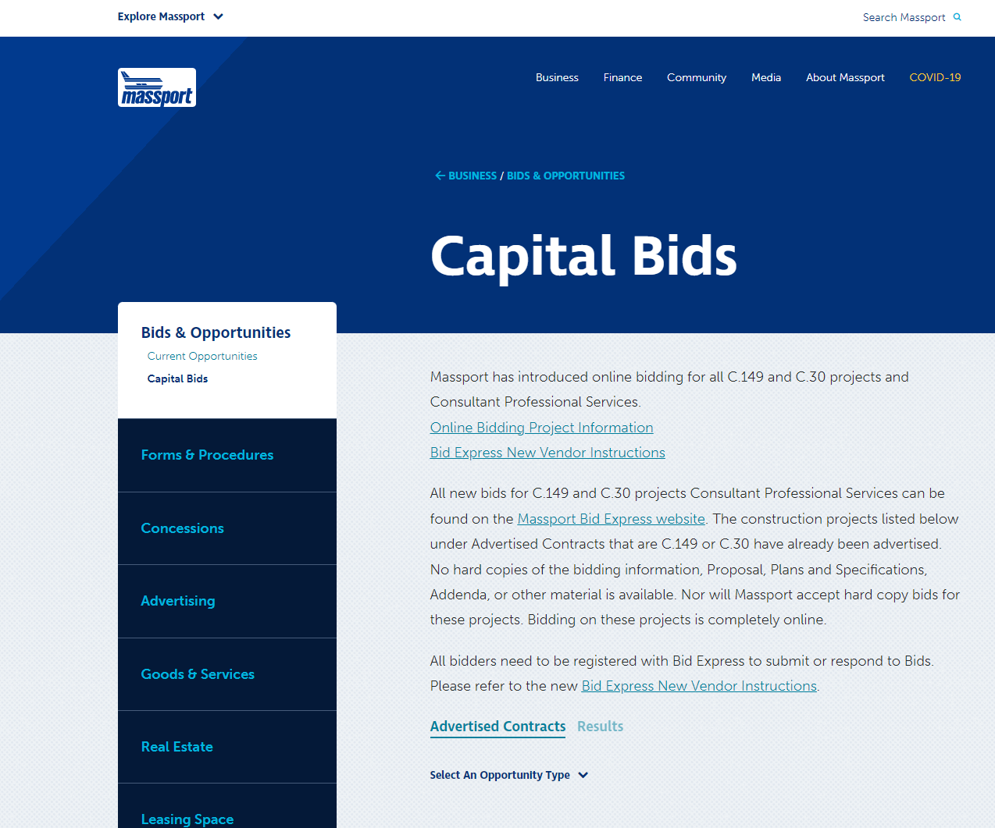
MPA L1840 LOGAN NPDES PERMIT INFRASTRUCTURE PROGRAM Consultant Briefing – Bid Express Info
Massport has introduced online bidding for all C.149 and C.30 projects
Consultant Professional Services RFQs for Projects Advertised after May 10, 2023 will be submitted through online bidding (BidExpress).
No hard copies of the bidding information, Proposal, Plans and Specifications, Addenda, or other material is available. Nor will Massport accept hard copy bids for these projects. Bidding on these projects is completely online.
Online Bidding Project Information
All new bids for C.149 and C.30 projects and Consultant Professional Services can be found on the Massport Bid Express website.

Slide 25
MPA L1840 LOGAN NPDES PERMIT INFRASTRUCTURE PROGRAM
Consultant Briefing – Bid Express Info
Massport has introduced online bidding for all C.149 and C.30 projects
Consultant Professional Services RFQs for Projects Advertised after May 10, 2023 will be submitted through online bidding (BidExpress).
No hard copies of the bidding information, Proposal, Plans and Specifications, Addenda, or other material is available. Nor will Massport accept hard copy bids for these projects. Bidding on these projects is completely online.
Online Bidding Project Information
All new bids for C.149 and C.30 projects and Consultant Professional Services can be found on the Massport Bid Express website.

Slide 26
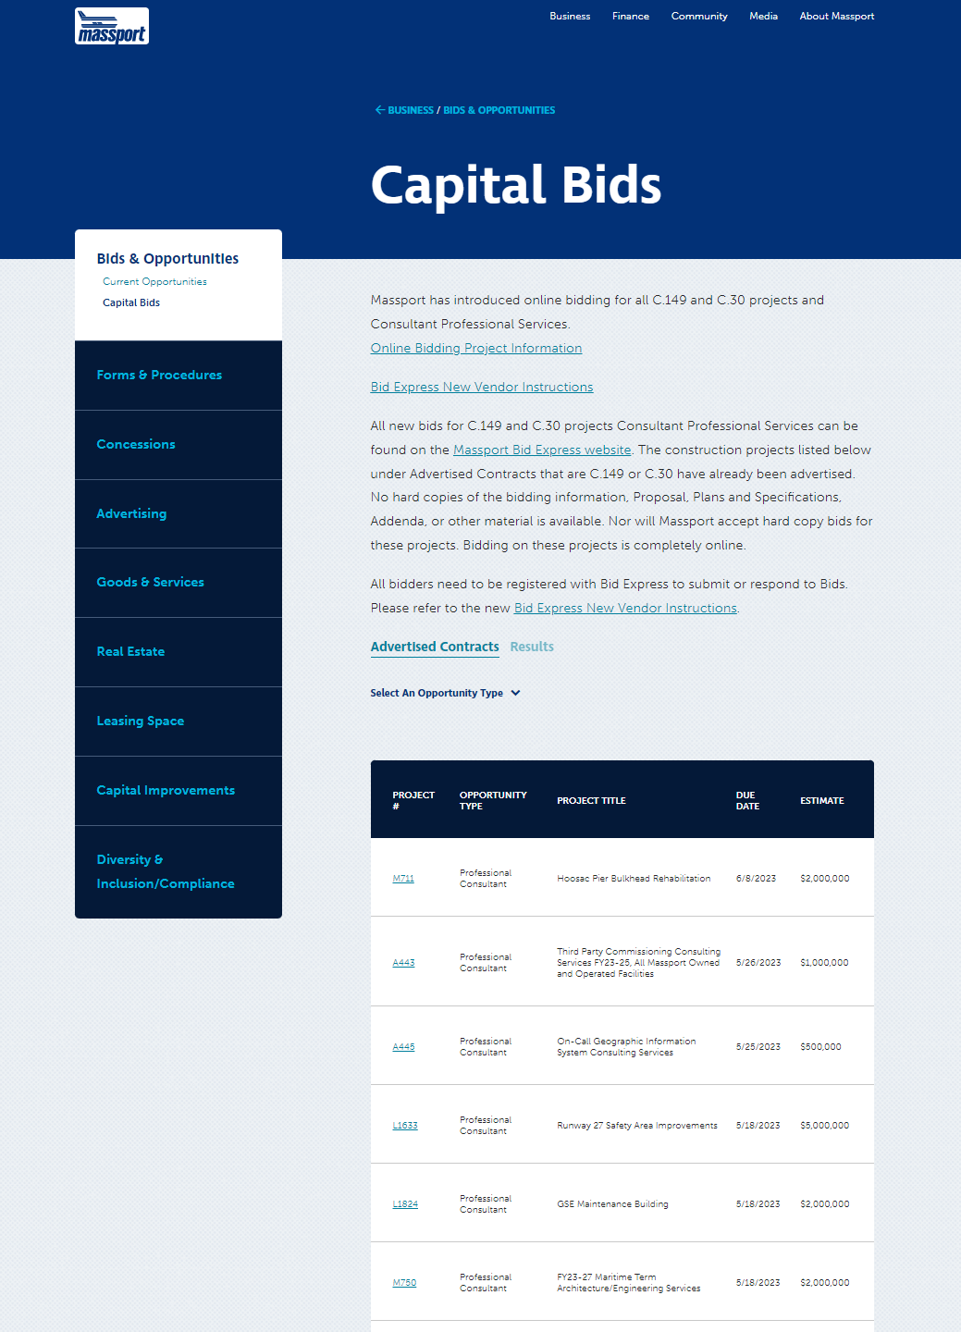
MPA L1840 LOGAN NPDES PERMIT INFRASTRUCTURE PROGRAM Consultant Briefing – Bid Express Info
The Professional Consultant RFQ’s will be listed under the appropriate project # and Project title on the Massport website: https://www.massport.com/massport/business/bids-opportunities/capital-bids/
Please submit qualification via Bid Express https://www.bidexpress.com/

Slide 27
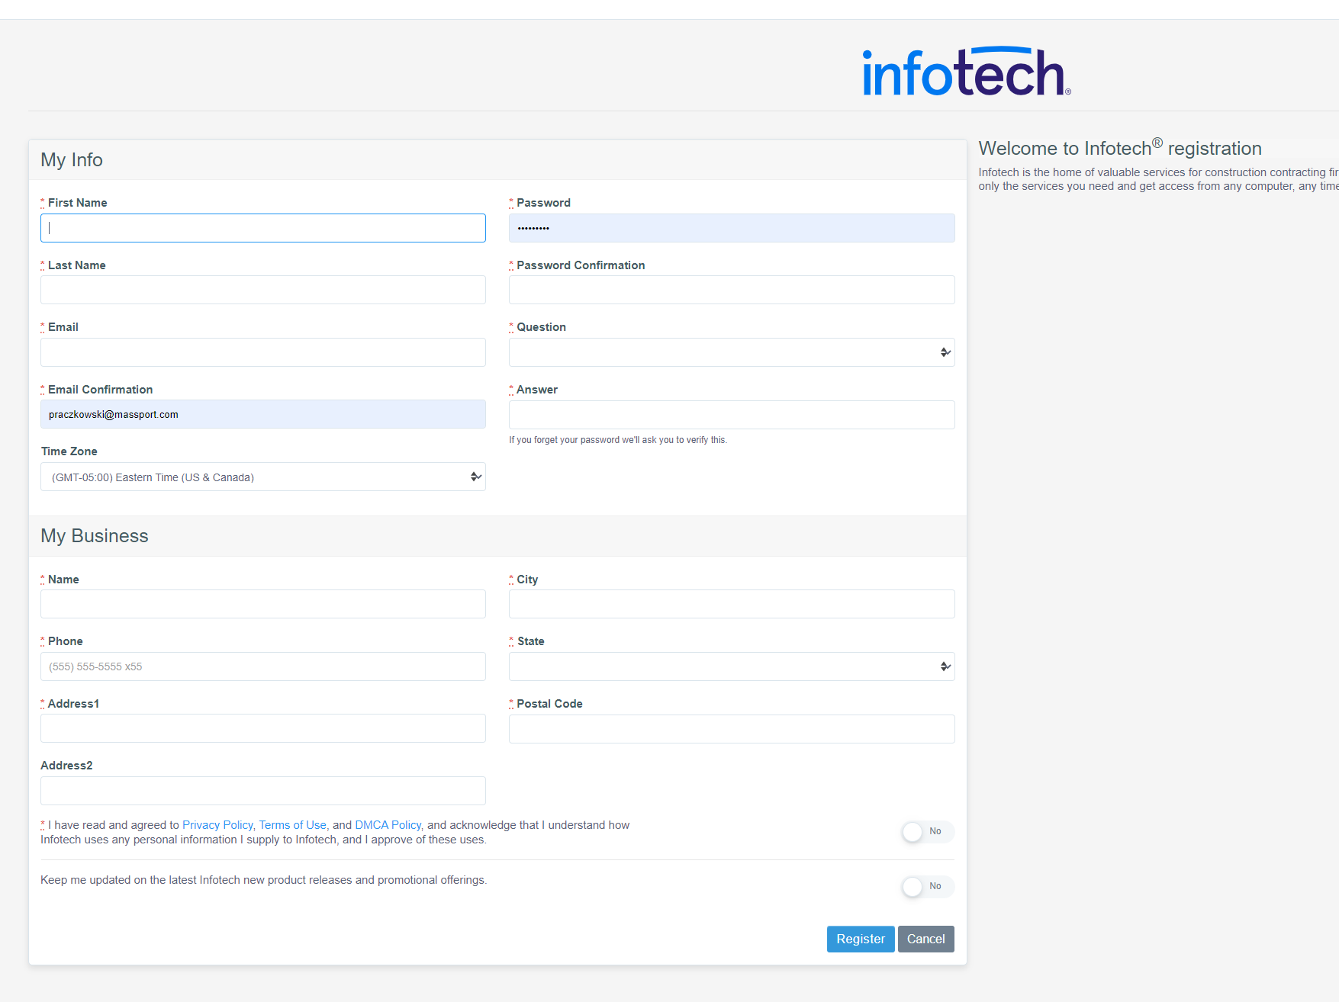
MPA L1840 LOGAN NPDES PERMIT INFRASTRUCTURE PROGRAM Consultant Briefing – Bid Express Info
All bidders need to be registered with Bid Express to submit or respond to Bids.
https://www.infotechexpress.com/registration/new
Please refer to the new Bid Express New Vendor Instructions: https://infotechinc.zendesk.com/hc/en-us/sections/12044610308375-Bid-Express-Vendors

Slide 28
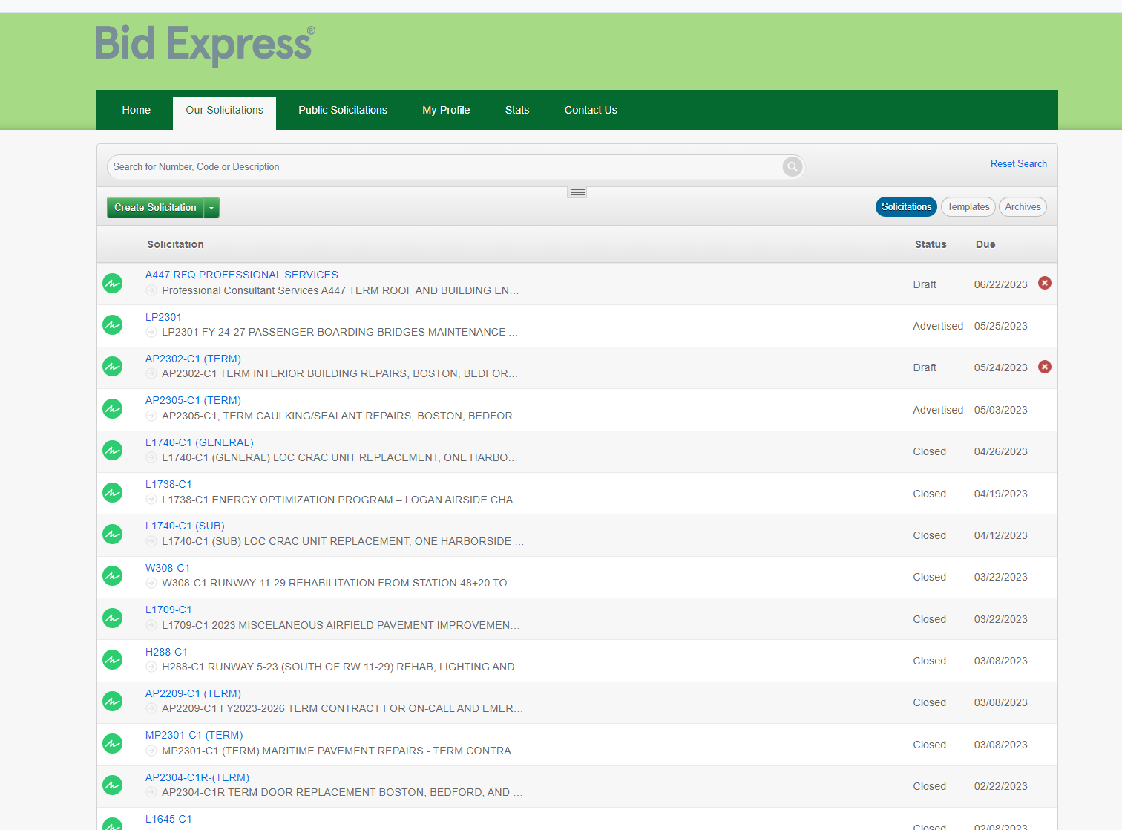
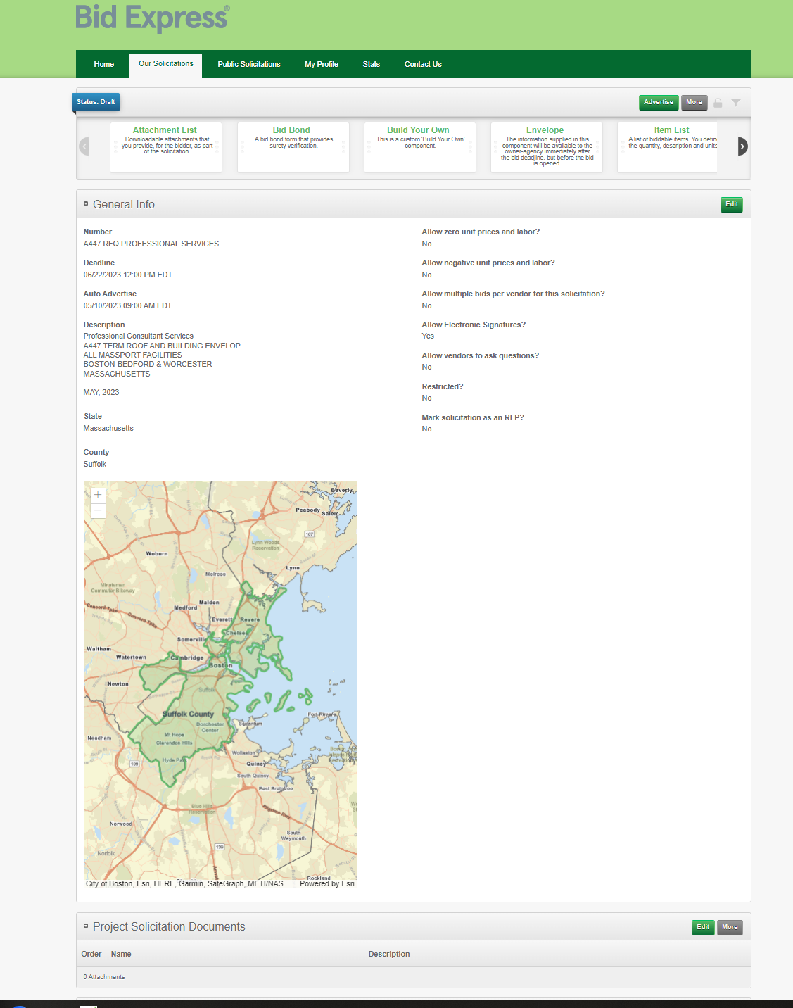
MPA L1840 LOGAN NPDES PERMIT INFRASTRUCTURE PROGRAM Consultant Briefing – Bid Express Info
A447 RFQ listed below in Bid Express
Submit Qualifications under Required Document List

