Slide 1


L1469
Street Lighting Replacement
Consultant Briefing
Logan International Airport (Landside)
East Boston, MA 02128
05.08.2024

Slide 2
L1469 Street Lighting Replacement, Logan Landside
Consultant Briefing
Attendees Introduction
Please enter your contact information in the Zoom Meeting chat window in following format:
  First & Last Name; Company Name & Position; Email Address

Slide 3
L1469 Street Lighting Replacement, Logan Landside
Consultant Briefing
Agenda
Expected Outcome: Gain insights into the L1469 RFQ requirements and understand the Bid Express submission process
Solicitation for Consultant Design Services
Background Information
Scope of Work
Evaluation Criteria
Submission Requirement
Submission Schedule
2. Bid Express Info

Slide 4
L1469 Street Lighting Replacement, Logan Landside
Consultant Briefing
Background
This project is part of Energy Optimization Program
Limits of this project is Logan International Airport, Landside
Provide Logan street lighting inventory assessment for Massport
Light pole foundations and wiring will need to be evaluated for possible upgrading as determined by the engineer

Slide 5
L1469 Street Lighting Replacement, Logan Landside
Consultant Briefing
Scope of Work
As a result of this project Logan International Airport (BOS) Street Lighting Inventory Assessment will be prepared, along with the plan, design, and provision of construction services for its upgrade and renewal.
Scope of work includes:
Review of existing conditions and making an inventory assessment
Capture required information on each pole
Develop design documents including cost estimates and specifications
Construction Administration Services
Resident Engineer / Construction Inspection
CAD file of the inventory assessment should be submitted for Massport GIS update
Review of existing wiring and conduit for potential utility cost saving recommendations

Slide 6
L1469 Street Lighting Replacement, Logan Landside
Consultant Briefing
Key Information for Light Pole Assessment
Pole Number
Pole location ( GPS coordinates)
Pole Manufacturer/ Model
Pole Installation date
Foundation Type and Condition
Anchor Plate and Bolts and their condition
Wiring and Conduit Condition
Pole Type
Pole Height
Power Source (Electricity, Solar Battery)
Luminaire Type, Number and Condition
Regulatory Signage on the pole
Compliance with current code and standard

Slide 7
L1469 Street Lighting Replacement, Logan Landside
Consultant Briefing
Evaluation Criteria
The submission shall be evaluated on the basis of the following equally weighted criteria:
(1) Demonstrated experience and knowledge of the team for similar projects of similar size and complexity particularly important to demonstrate for the Project Manager. Highlight the experience and expertise for major sub-consultants and their assigned staff. Familiarity with public construction procurement under MGL Ch. 30, and
(2) Project understanding and proposed technical approach including QA/QC process during document preparation, cost management and scheduling capabilities, construction oversight, ability to plan and perform work with minimal disruption to operations, and
(3) Demonstrated experience in integrating and managing BIM/VDC in the planning, design and construction. Experience of utilizing Lean Design & Construction (Last Planner System®, Scrum or others tools) to increase the reliability and significantly improve projects and teams’ performance, and

Slide 8
L1469 Street Lighting Replacement, Logan Landside
Consultant Briefing
Evaluation Criteria
Continued…..
(4) Demonstrated project experience in sustainable and resilient high performance building and infrastructure design and construction, including experience with low, net zero ready or net zero emissions, water, and waste, lifecycle analysis including embodied carbon, innovative renewable energy strategies, and building and infrastructure sustainability certification schemes relevant to this proposal. Firms are encouraged to demonstrate “outside of the box” thinking for examples of inclusion of sustainable practices into its projects, and specify how those practices may be applied to this project proposal. Firms must demonstrate the capability to incorporate design features into any project type that reflect best practices in environmental stewardship, and
(5) Proposed approach to enhance diversity and inclusion of the project team to increase the pool of consultants working on the Authority’s projects. For those M/WBE firms proposed, please describe type and/or category of work (i.e. architecture, structural, Lean, etc.); include the specific roles to be played by M/WBE, and the extent to which such M/WBE involvement is anticipated as of date of the proposal submission. (% goal)

Slide 9
L1469 Street Lighting Replacement, Logan Landside
Consultant Briefing
Submission Requirements
The Authority may reject any application if any of the required information is not provided: Cover Letter, Insurance Requirements and SF330 Part IIs for the Prime and every sub-consultant.
Make sure that the Cover Letter is signed “Under the pains and penalties of perjury”, and that you mention the Insurance in the Cover Letter itself.

Slide 10
Architect/Engineer & Related Services questionnaires SF 330 New Link
The link provided for the SF 330 Questionnaire in the Submission Requirements section of the RFQ is not working. Please use the following links instead.
https://www.gsa.gov/reference/forms/architectengineer-qualifications
Or
https://www.gsa.gov/system/files/SF330-21.pdf

Slide 11
L1469 Street Lighting Replacement, Logan Landside
Consultant Briefing
Submission Schedule
RFQ questions sent via email to CPBidQuestions@massport.com
In the subject lines of your email, please reference L1469 – Street Lighting Replacement, Logan Landside
Deadline for questions: Monday, May 13, 2024@ 12:00 PM (noon)
Questions and responses will be posted on the Bid Express and Massport website
(http://www.massport.com/massport/business/bids-opportunities/capital-bids) as an attachment to the original Legal Notice and on
COMMBUYS (www.commbuys.com) in the listings for this project.
EVENT | DATE/TIME
Solicitation: Release Date & Supplemental Package Available | Wednesday May 1, 2024
Consultant Briefing | Wednesday May 8, 2024 at 11:00 A.M.
Deadline for submission of written questions | Monday May 13, 2024 at 12:00 P.M. (noon)
Official answers published (Estimated) | Friday May 17, 2024
Solicitation: Close Date / Submission Deadline | Thursday June 13, 2024 at 12:00 PM (noon)

Slide 12
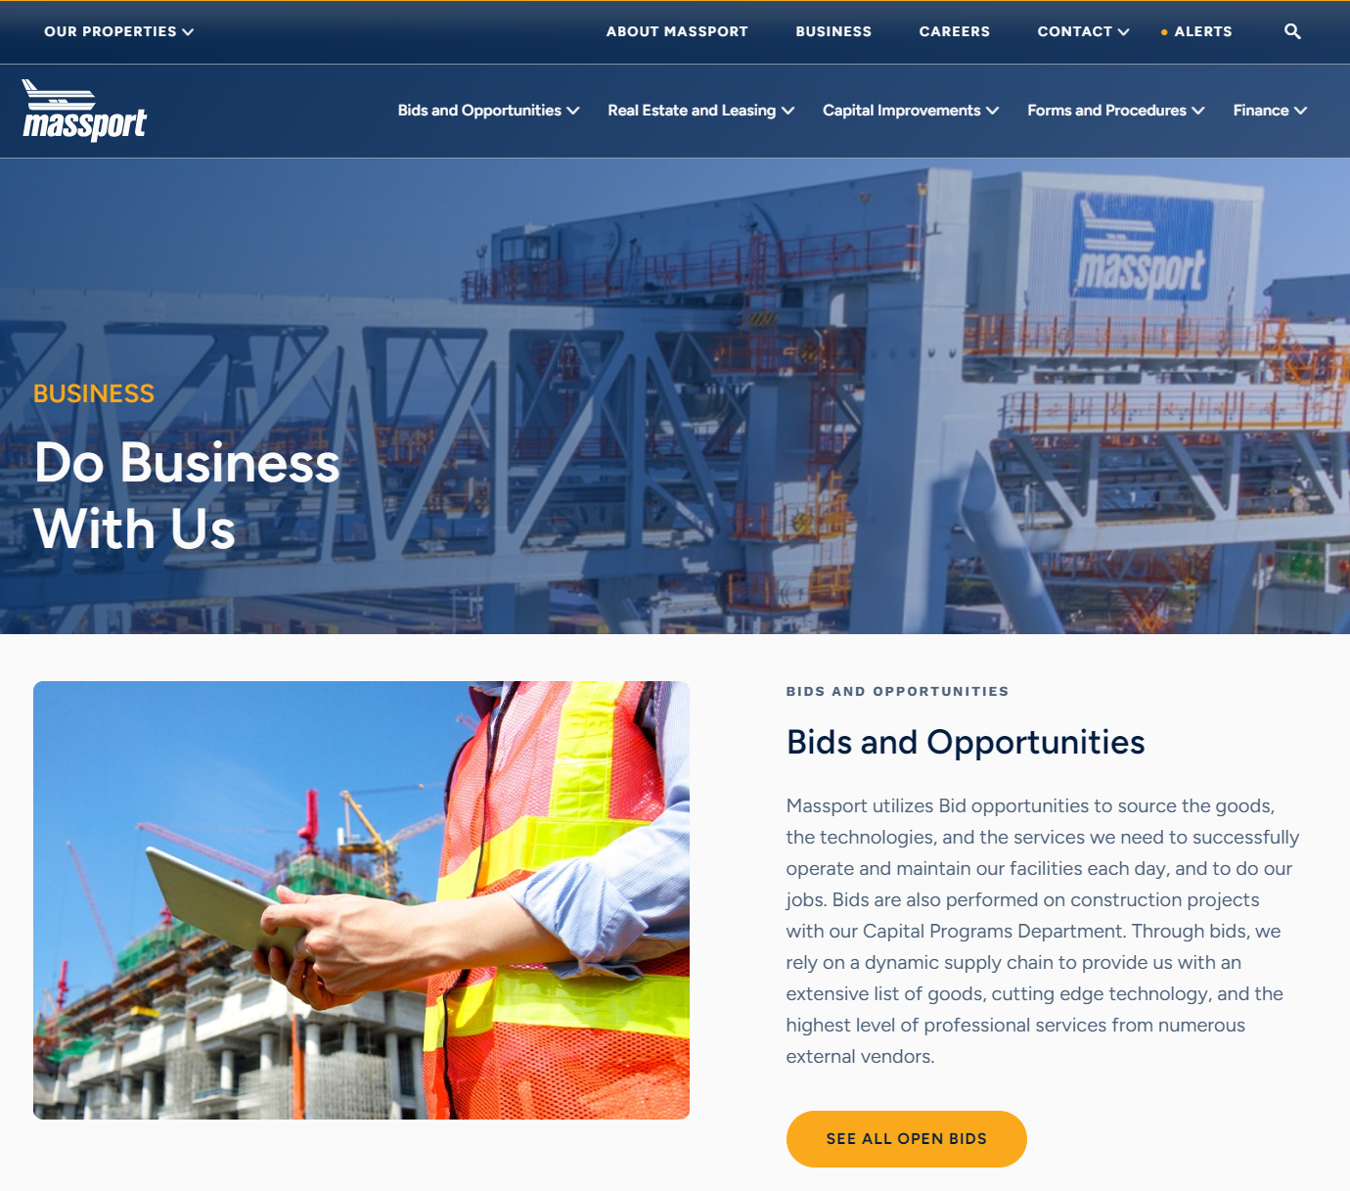
L1469 Street Lighting Replacement, Logan Landside
Consultant Briefing– Bid Express Info
Massport new website launched on 12/05/2023
Massport has introduced online bidding for all C.149 and C.30 projects Including Consultant Procurement
Consultant Professional Services RFQs for Projects Advertised after May 10, 2023 will be submitted through online bidding (BidExpress).
No hard copies of the bidding information, Proposal, Plans and Specifications, Addenda, or other material is available. Nor will Massport accept hard copy bids for these projects. Bidding on these projects is completely online.
Online Bidding Project Information
All new bids for C.149 and C.30 projects and Consultant Professional Services can be found on the Massport Bid Express website.

Slide 13
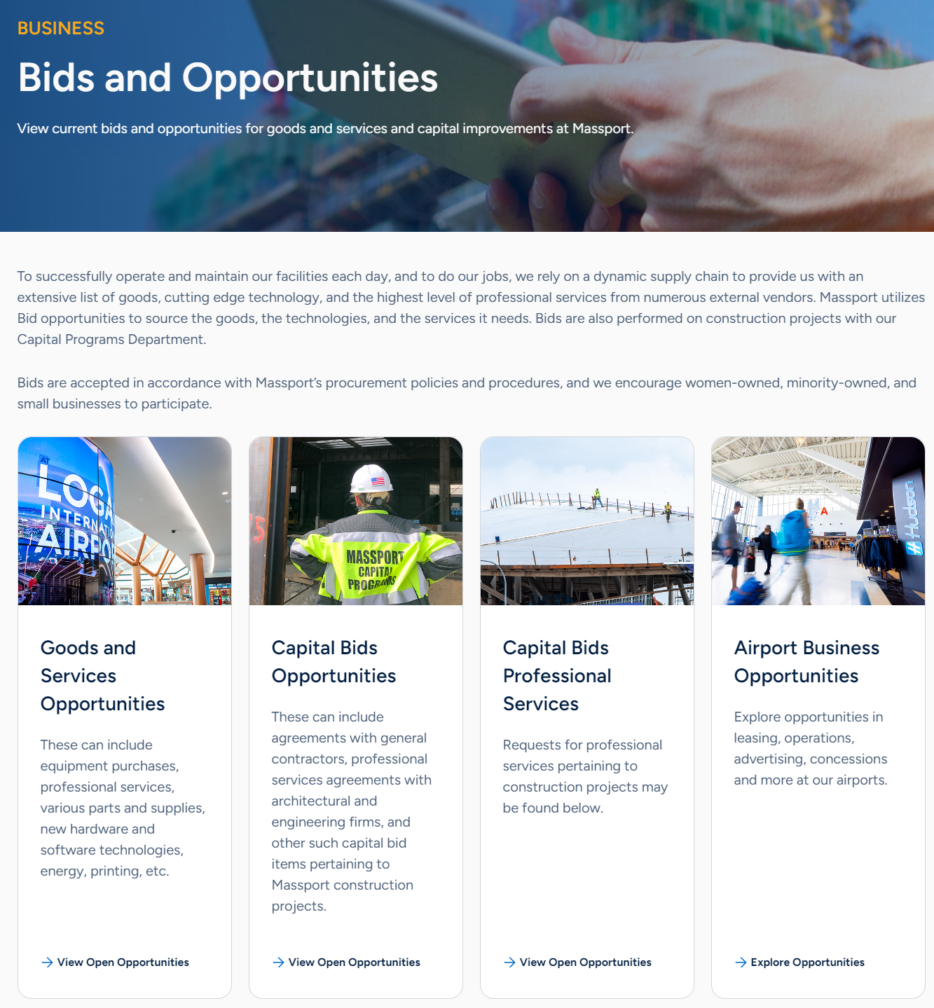
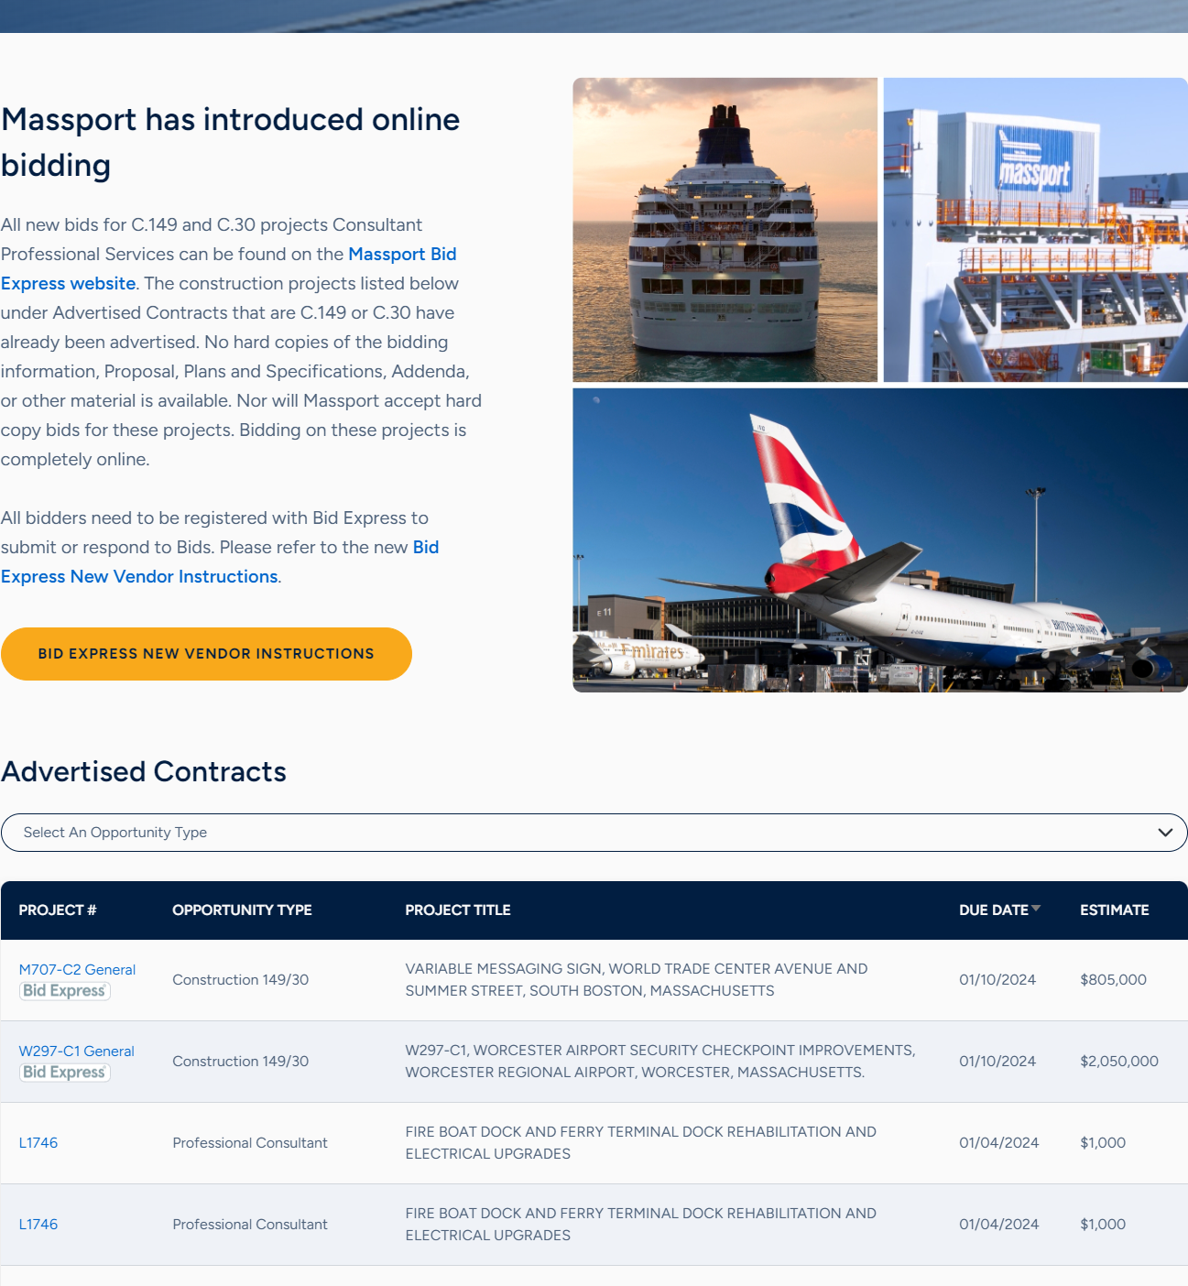
L1469 Street Lighting Replacement, Logan Landside
Consultant Briefing– Bid Express Info
The Professional Consultant RFQ’s will be listed under the appropriate project # and Project title on the Massport website: https://www.massport.com/business/bids-and-opportunities/capital-bids
Please submit qualification via Bid Express https://www.bidexpress.com/

Slide 14
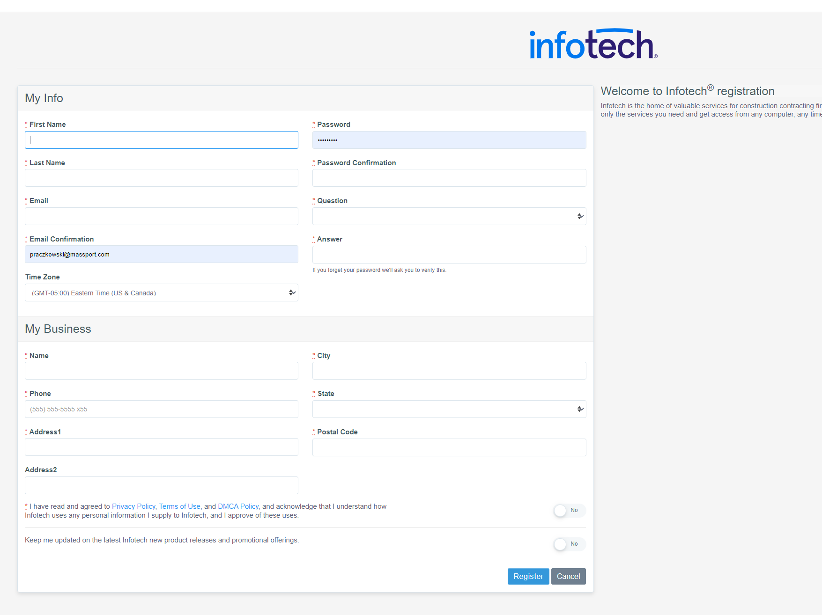
L1469 Street Lighting Replacement, Logan Landside
Consultant Briefing– Bid Express Info
All bidders need to be registered with Bid Express to submit or respond to Bids.
https://www.infotechexpress.com/registration/new
Please refer to the new Bid Express New Vendor Instructions: https://infotechinc.zendesk.com/hc/en-us/sections/12044610308375-Bid-Express-Vendors

Slide 15
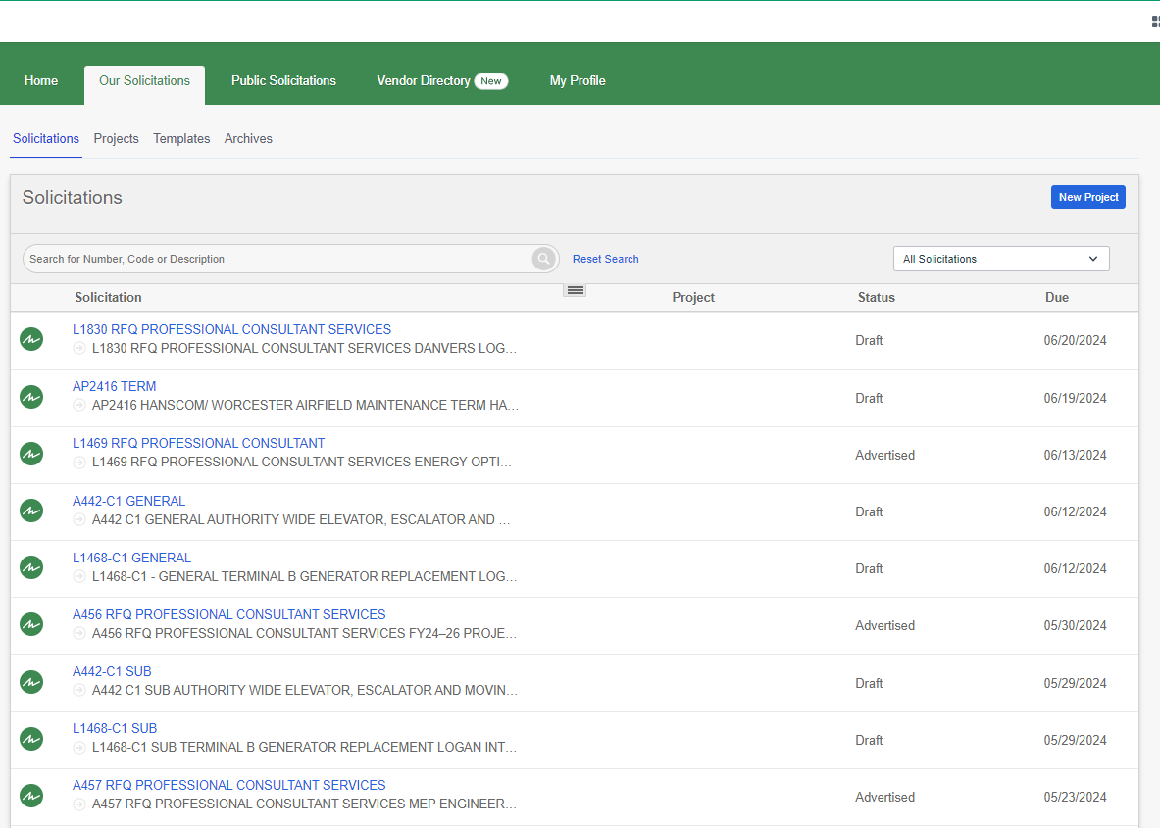
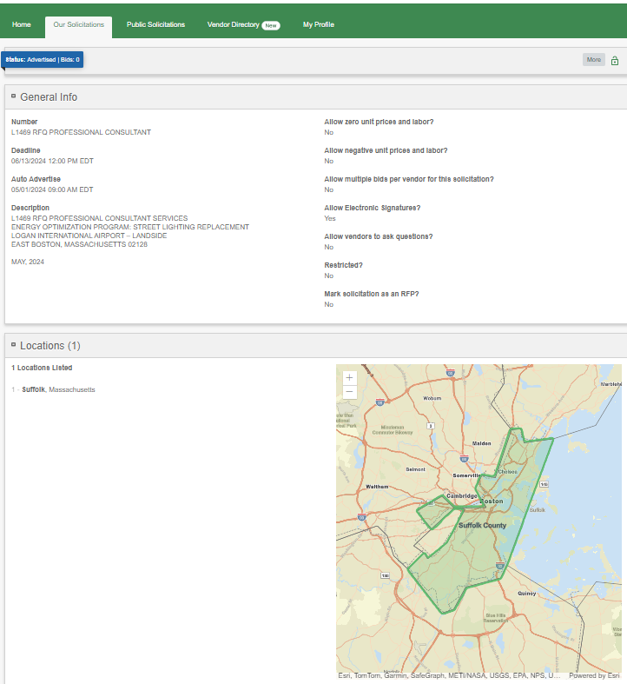
L1469 Street Lighting Replacement, Logan Landside
Consultant Briefing– Bid Express Info
L1469 RFQ listed below in Bid Express
Submit Qualifications under Required Document List

Slide 16
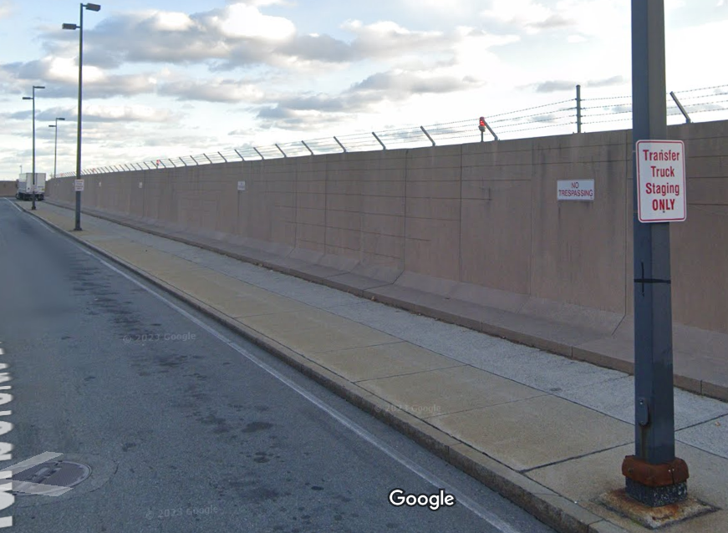
THANK YOU!

Slide 17
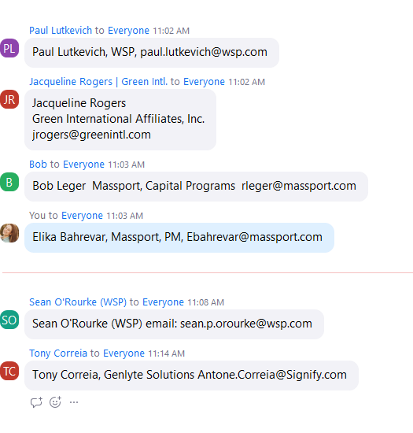
1- Paul Lutkevich, WSP, Paul.lutkevich@wsp.com
2- Jacqueline Rogers, Green International Affiliates, Inc., jrogers@greenintl.com
3-Sean O’Rourke, WSP, sean.p.orourke@wsp.com
4- Tony Correia, Genlyte Solutions, Antone.correia@signify.com
5- Bob Leger, Massport, rleger@massport.com
6- Elika Bahrevar, Massport, ebahrevar@massport.com

